Slide 1
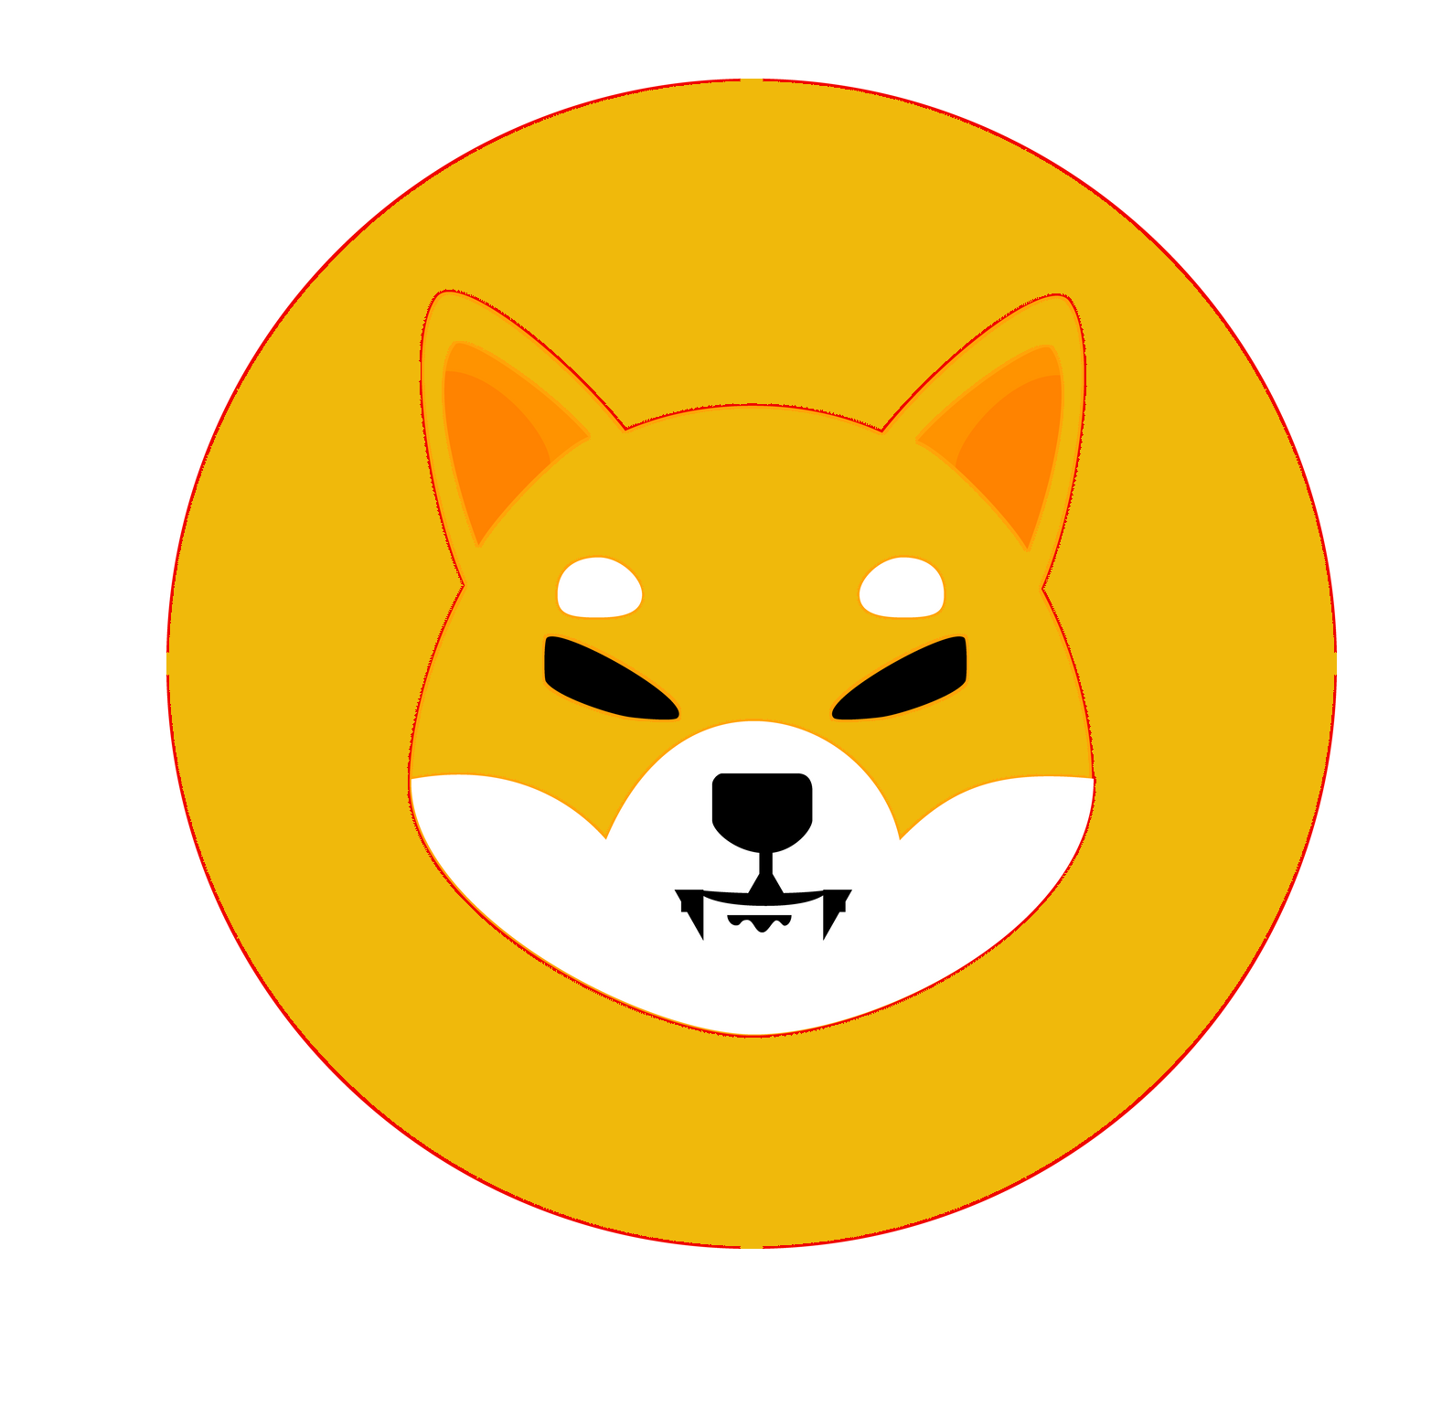
MINO INU
Whitepaper V.1.1
powered by

Slide 2
MINO INU: Redefining Memecoin on the Binance Smart Chain Abstract
MINO INU is a community-driven cryptocurrency built on the Binance Smart Chain network (BSC). Leveraging the speed and cost-effectiveness of BSC, MINO INU aims to revolutionize the meme coin space by offering a decentralized, secure, and scalable platform for users to participate in the burgeoning world of cryptocurrencies.
Table of Contents
1. Introduction
2. Problem Statement
3. Solution
4. Key Features
5. Tokenomics
6. Roadmap
7. Team and Community
8. Conclusion

Slide 3
1. Introduction
In recent years, meme coins have gained significant popularity in the cryptocurrency space. However, many of these projects face challenges such as high transaction fees and slow transaction times on the Ethereum network. MINO INU addresses these issues by utilizing the Binance Smart Chain, offering users faster transaction speeds and lower fees.
2. Problem Statement
Existing meme coins often suffer from scalability issues and high gas fees, limiting their utility and accessibility to users. Additionally, the lack of transparency and community involvement in many projects has led to distrust among investors.
3. Solution
MINO INU provides a solution to these challenges by leveraging the Binance Smart Chain network, which offers fast transaction times and low fees. Through decentralization and community governance, MINO INU ensures transparency and fosters active participation from its community members.

Slide 4
2. Problem Statement
Existing meme coins often suffer from scalability issues and high gas fees, limiting their utility and accessibility to users. Additionally, the lack of transparency and community involvement in many projects has led to distrust among investors.

Slide 5
3. Solution
MINO INU provides a solution to these challenges by leveraging the Binance Smart Chain network, which offers fast transaction times and low fees. Through decentralization and community governance, MINO INU ensures transparency and fosters active participation from its community members.

Slide 6
4. Key Features
Fast and Low-Cost Transactions: Utilizing the Binance Smart Chain network for quick and cost-effective transactions.
Community Governance: Empowering the community to participate in decision-making processes through governance mechanisms.
Secure and Transparent: Implementing robust security measures and ensuring transparency through public audits and open communication.
Deflationary Mechanism: Incorporating a deflationary tokenomics model to incentivize holders and discourage speculation.

Slide 7
5) Tokenomics
MINO INU Coin (MINO) is the native currency of the ecosystem. It is designed with the following tokenomics:
Total Supply: 1,000,000,000,000,000
Distribution: [70% will be locked in the pool forever]
Deflationary Mechanism: Burns 1% Buy and sale
Liquidity 1% fees
Marketing Fees 5%
Sell Fees 5%

Slide 8
6. Roadmap
Q1 2024:, Community Growth Social media
Pre-sale Gempad – Coinmarketcap listing
Security Audits / Contract Renounce
KYCE / Liquidity Lock 365 days.
Q2 2024: Marketing influencers
Social media advertainment /
Q3 2024: Listing on Decentralized Exchanges, Marketing Campaigns.
Q4 2024: Further Expansion, Partnerships, Integration with DeFi platforms. Application wallet easy buy and sale.

Slide 9
7. Team and Community
MINO INU is backed by a team of experienced developers, marketers, and community managers dedicated to driving the project forward. The project also boasts a vibrant and engaged community of supporters who actively contribute to its growth and development.

Slide 10
8. Conclusion
MINO INU aims to redefine the meme coin landscape by offering a decentralized, scalable, and community-driven platform on the Binance Smart Chain network. With its innovative features and strong community support, MINO INU is poised to become the next big player in the cryptocurrency space.

